Slide 1

SENTIMENTAL ANALYSIS OF ONLINE REVIEWS
Vihaan Subhash Matturi |QR39094 |DATA-606 |Spring 2023

Slide 2

INTRODUCTION
Online reviews are a rich source of text data that may be examined to learn what customers think and feel about a product or service.
Businesses may discover what customers like and hate about their goods and services by examining online reviews.
Customers' demands may be better understood, and products and services can be improved with the use of this knowledge.
NLP may be a valuable technique for assessing online reviews. Businesses may use NLP to extract information from online feedback that would be difficult or impossible to obtain manually. .
This project is a great example of how NLP can be used to improve business. The goal of the sentiment analysis model of online reviews is use NLP techniques such as topic modeling, Bag of words, and word embedding to automatically recognize and categorize the sentiment indicated in a written text as positive or negative.

Slide 3
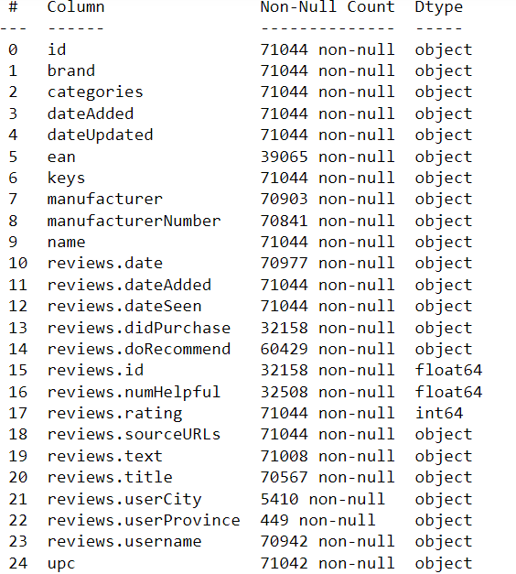
ABOUT DATASET
The dataset has been collected https://data.world/datafiniti/grammar-and-online-product-reviews website and is a .csv file consisting of information of over 71,045 online reviews form 1000 different Products provided by Datafiniti's Product Database.
The dataset includes the text and title of the review, the name and manufacturer of the product, reviewer metadata, and more.

Slide 4
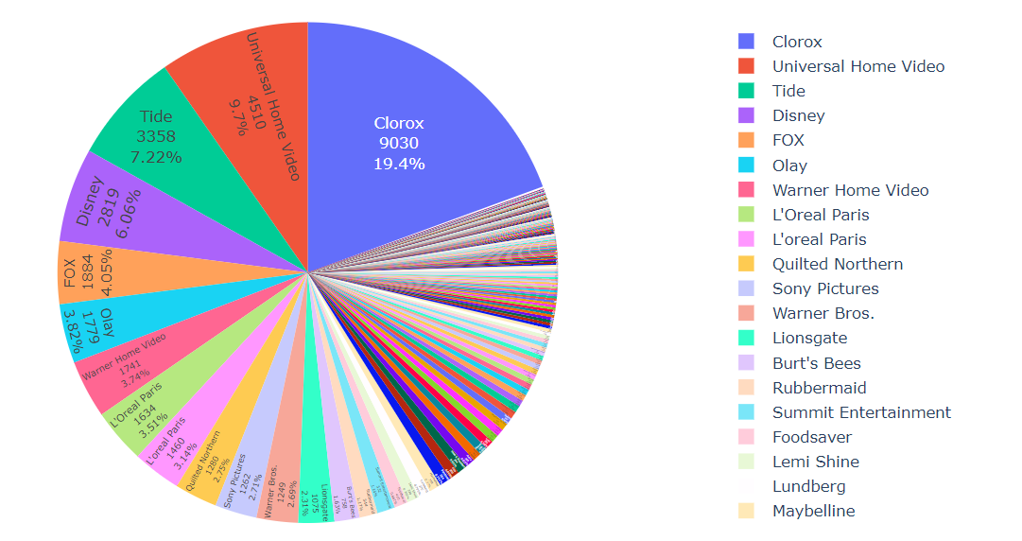
Distribution of 5-star ratings by brand

Slide 5
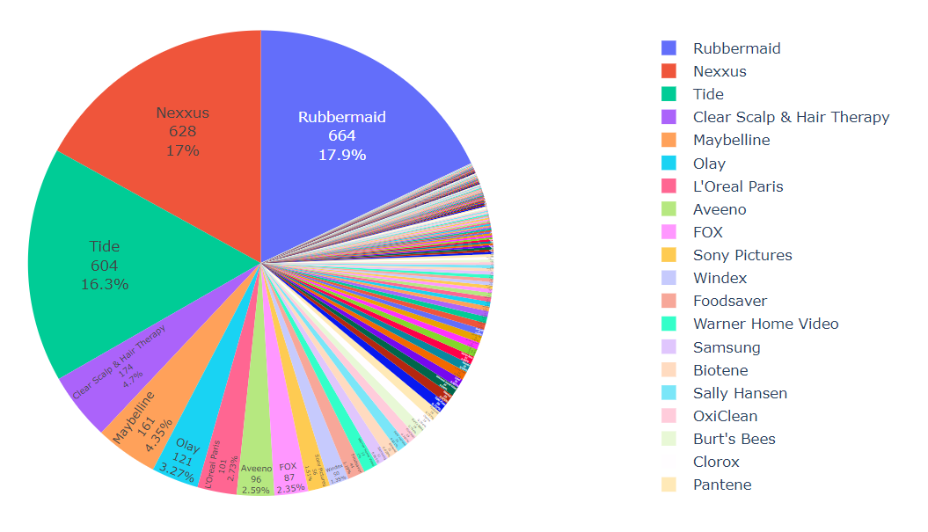
Distribution of 1-star ratings by brand

Slide 6

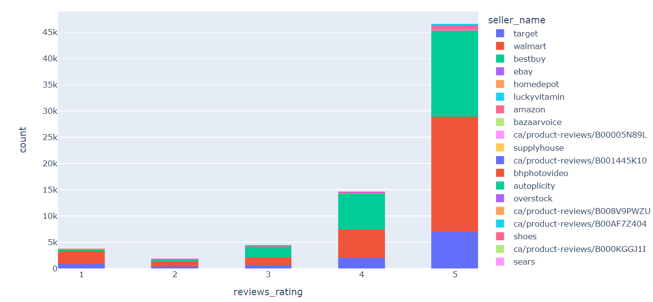
Distribution of Rating

Slide 7
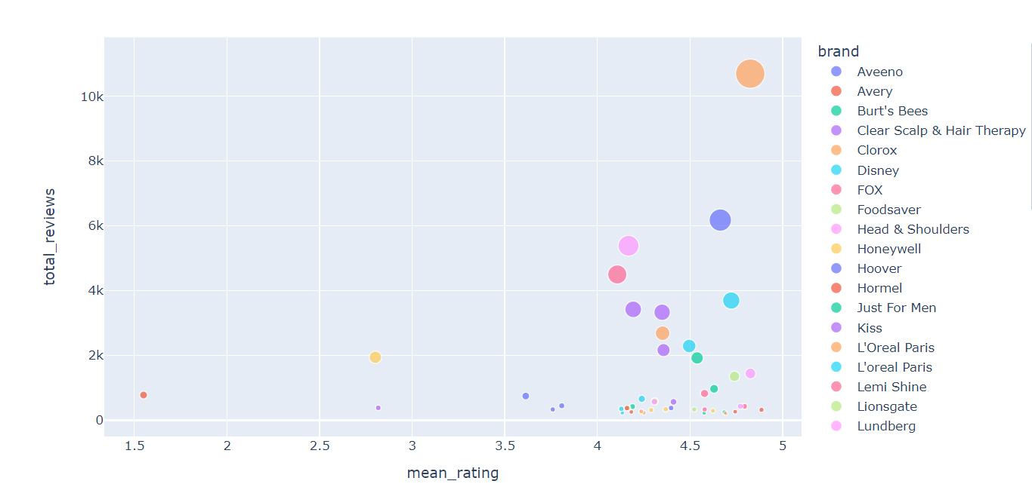
Determining the average rating for each brand

Slide 8
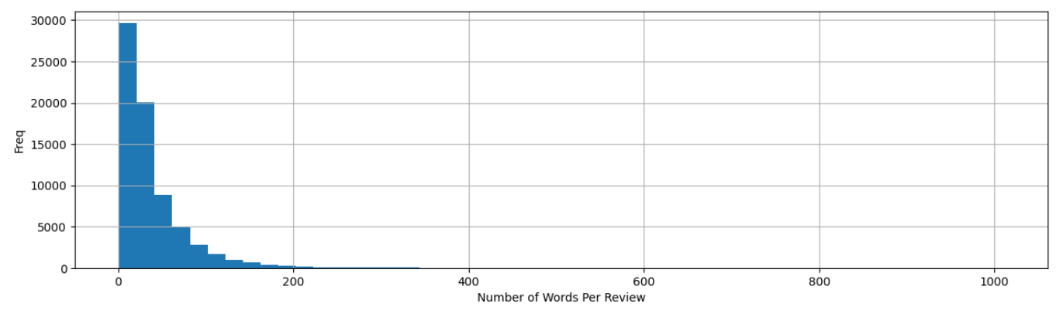
Determining the Words Per Review
The graph is positively skewed and reveals that almost all of the reviews have a total of 200 words per review as maximum and 30 words as average review which can be used in order to analyze the reviews.

Slide 9
TEXT PREPROCESSING TASKS
Splitting text into individual words or tokens.
Stop word removal
Removing punctuation
Converting text to lowercase
Stemming
lemmatizing words

Slide 10
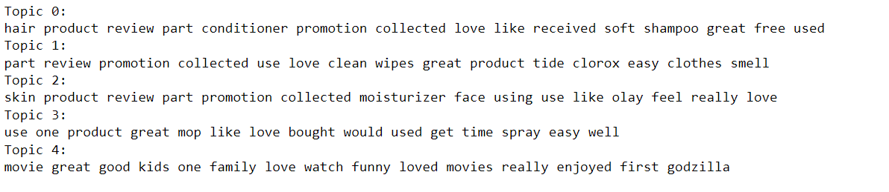
Topic Modelling
Latent Dirichlet Allocation (LDA):
LDA is a popular topic modeling algorithm that is relatively easy to understand and implement.
Probabilistic Latent Semantic Analysis (PLSA):
PLSA is another popular topic modeling algorithm that is similar to LDA.
Non-negative Matrix Factorization (NMF):
NMF is a topic modeling algorithm that is often used for image analysis.
Statistical analysis that identifies the hidden thematic structure in a collection of documents

Slide 11
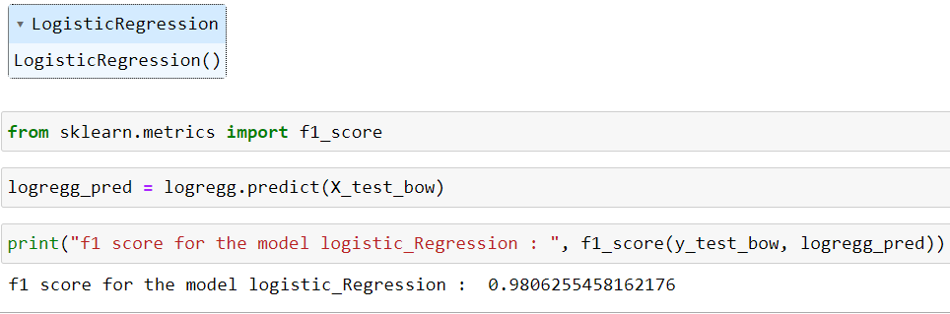
Bag of Words
Logistic regression For Bag of Words:
Vector space model.
In this model, a text is represented as the bag (multiset) of its words, disregarding grammar and even word order but keeping multiplicity.
Occurrence of each word is used as a feature for training a classifier.

Slide 12
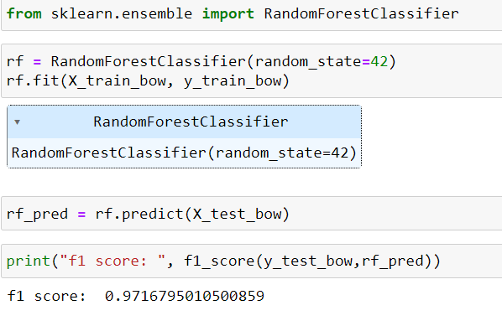
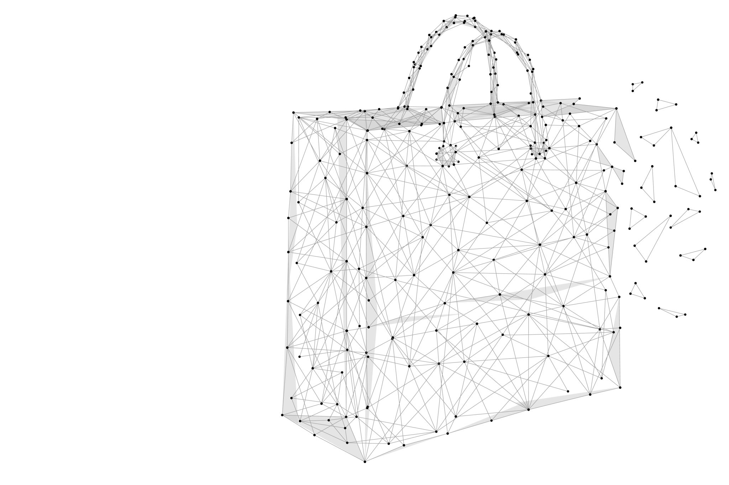
Bag of Words
Random Forest Classifier For Bag of Words:

Slide 13
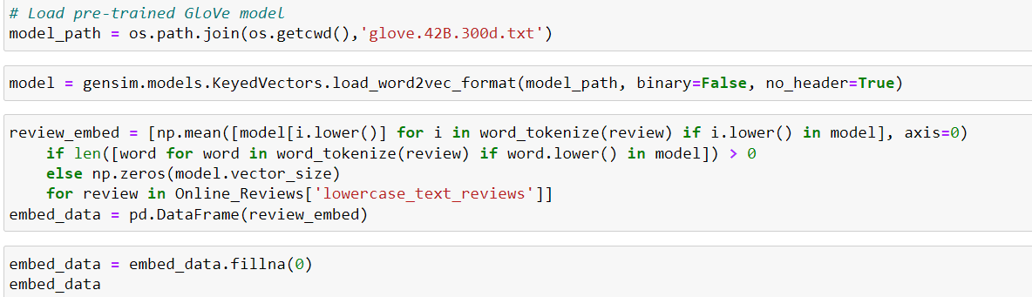
Word Embeddings Model
It is a real-valued vector that encodes the meaning of the word in such a way that words that are close in the vector space are expected to be similar in meaning.
Pre-Trained Glove model is taken from https://nlp.stanford.edu/projects/glove/

Slide 14
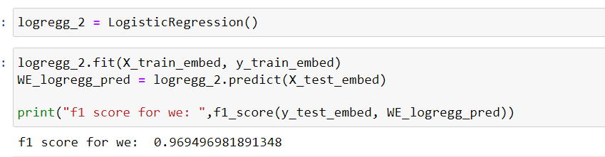
Word Embeddings Model
LogisticRegression for Word Embedding Model

Slide 15
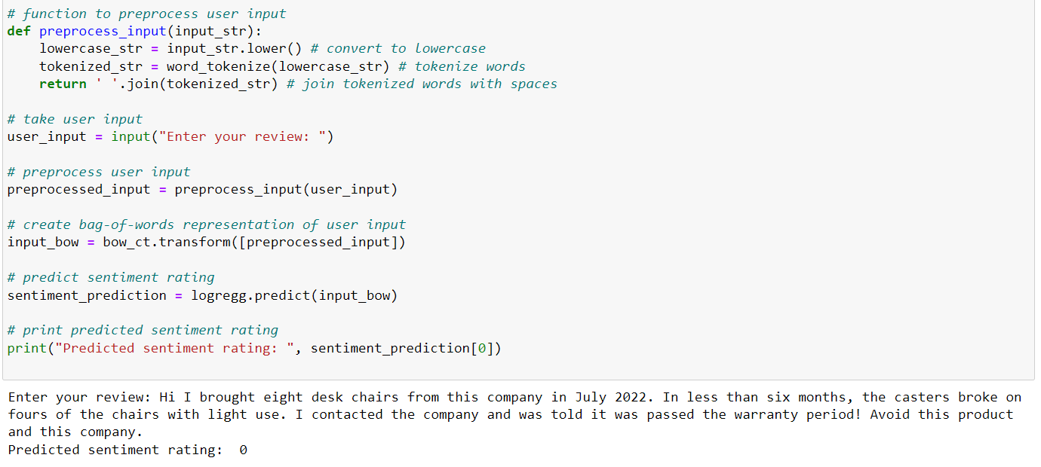
Predicting Sentiment from user Input:

Slide 16
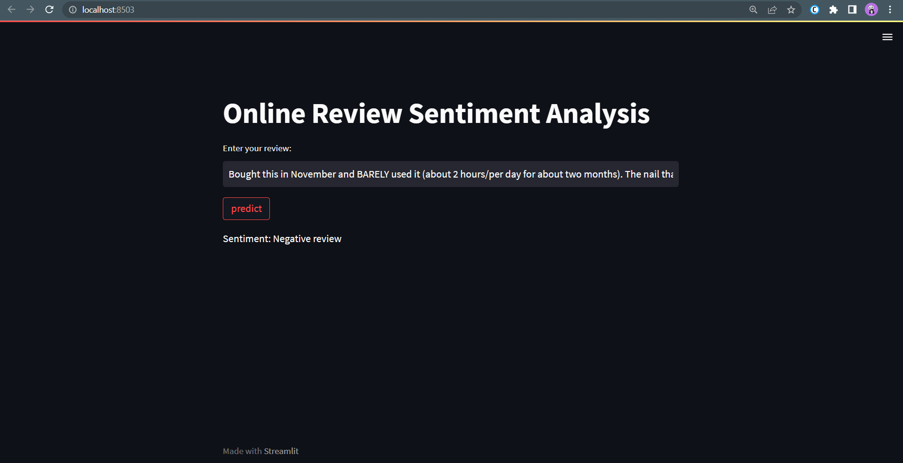
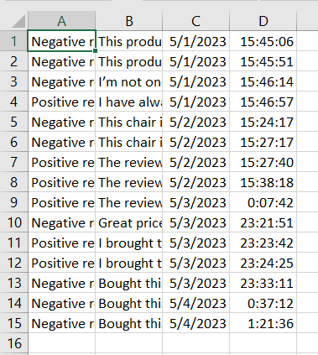
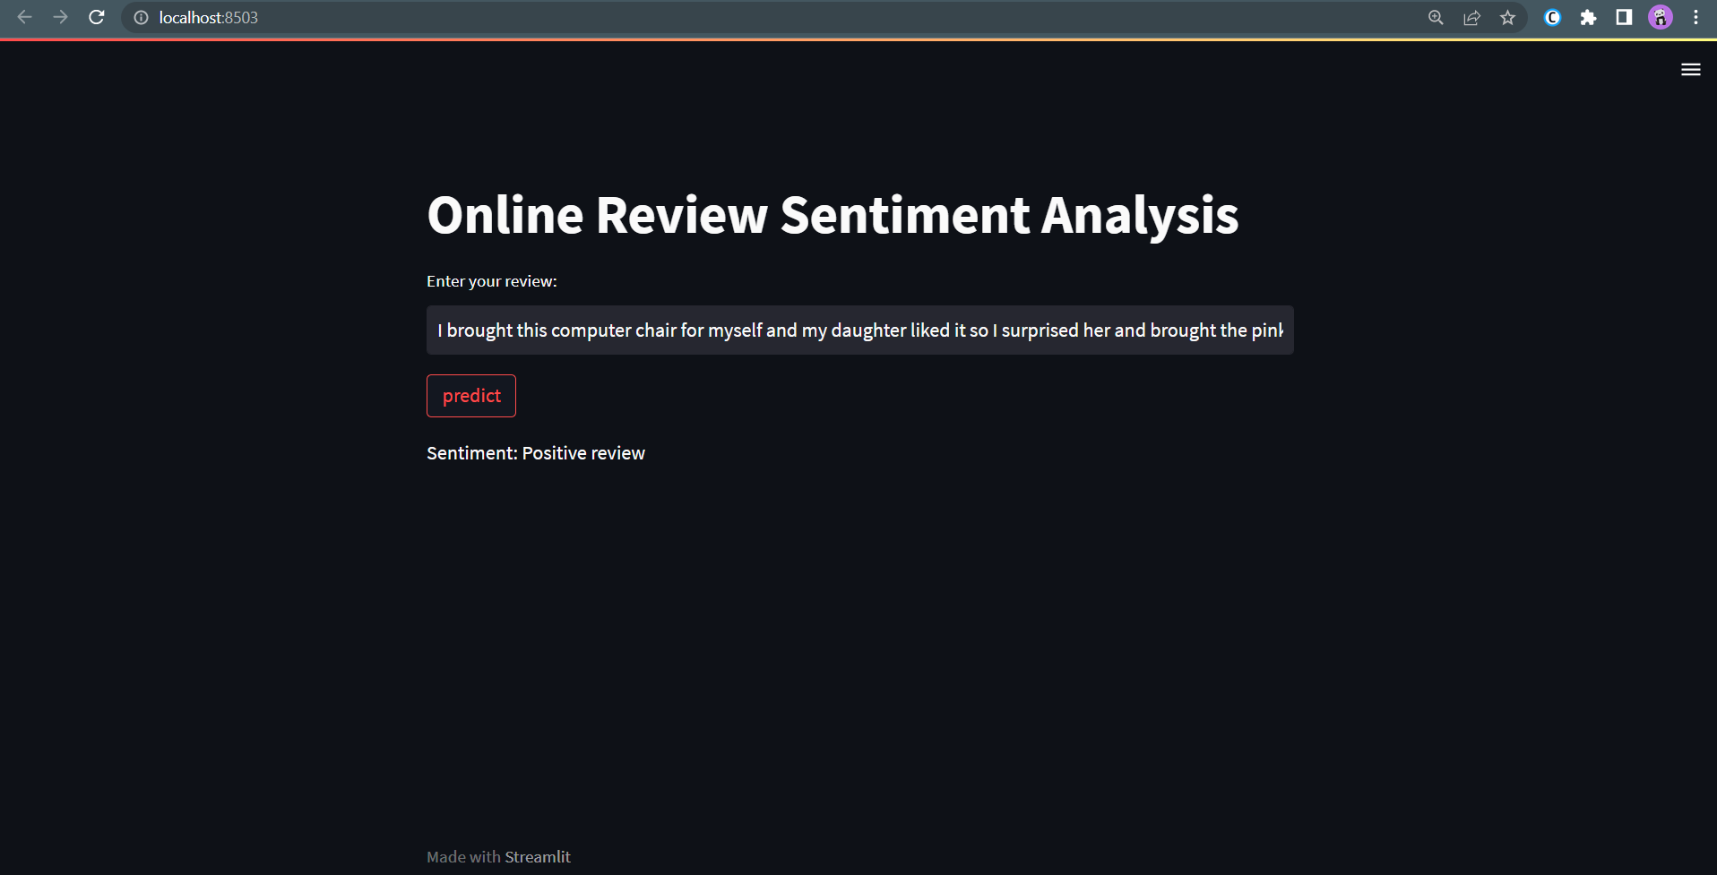
Web-Application using Streamlit

Slide 17

Thank you

